Slide 1
Hamiltonian Monte Carlo
2022/06/14
Cheng-Yu Hung

Slide 2
Some Review of MCMC

Slide 3
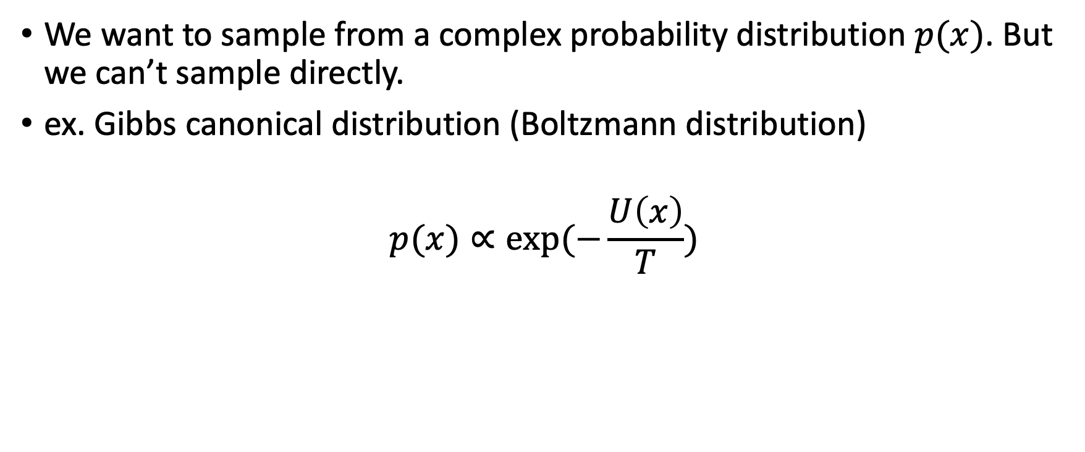
Review
We want to sample from a complex probability distribution $p(x)$. But we can’t sample directly.
ex. Gibbs canonical distribution (Boltzmann distribution)
$$p(x)∝exp⁡(−\frac{U\left(x\right)}{T})$$

Slide 4
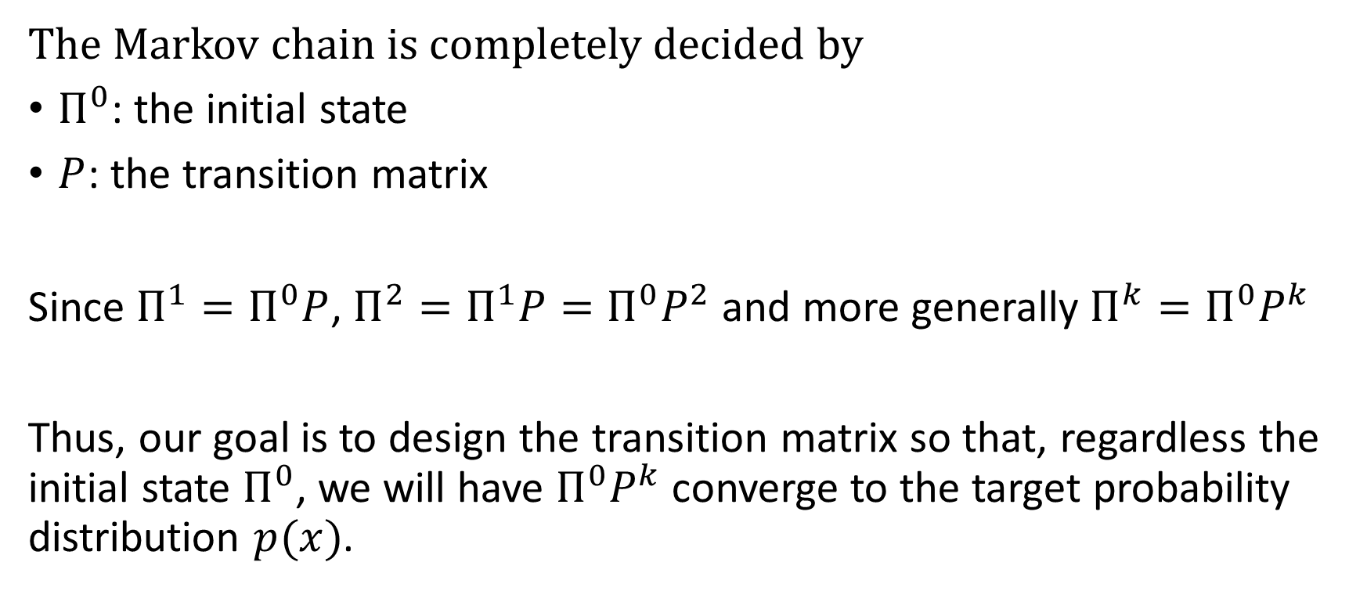
Markov Chain
The Markov chain is completely decided by
$Π^{0}$: the initial state
$P$: the transition matrix
Since $Π^{1}=Π^{0}P$, $Π^{2}=Π^{1}P=Π^{0}P^{2}$ and more generally $Π^{k}=Π^{0}P^{k}$
Thus, our goal is to design the transition matrix so that, regardless the initial state $Π^{0}$, we will have $Π^{0}P^{k}$ converge to the target probability distribution $p(x)$.

Slide 5
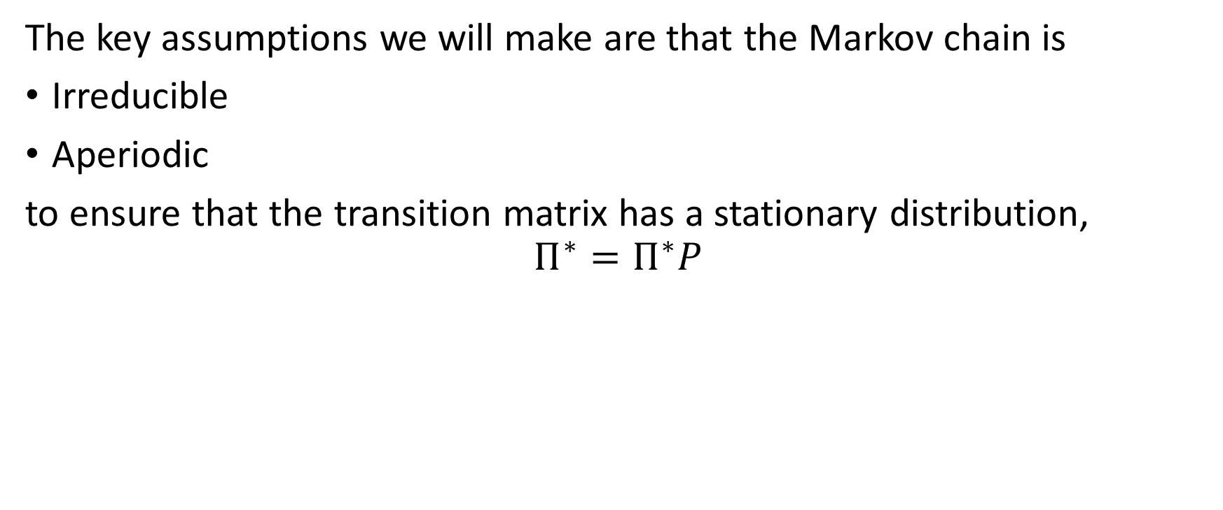
Markov Chain
The key assumptions we will make are that the Markov chain is
Irreducible
Aperiodic
to ensure that the transition matrix has a stationary distribution,
$$Π^{∗}=Π^{∗}P$$

Slide 6
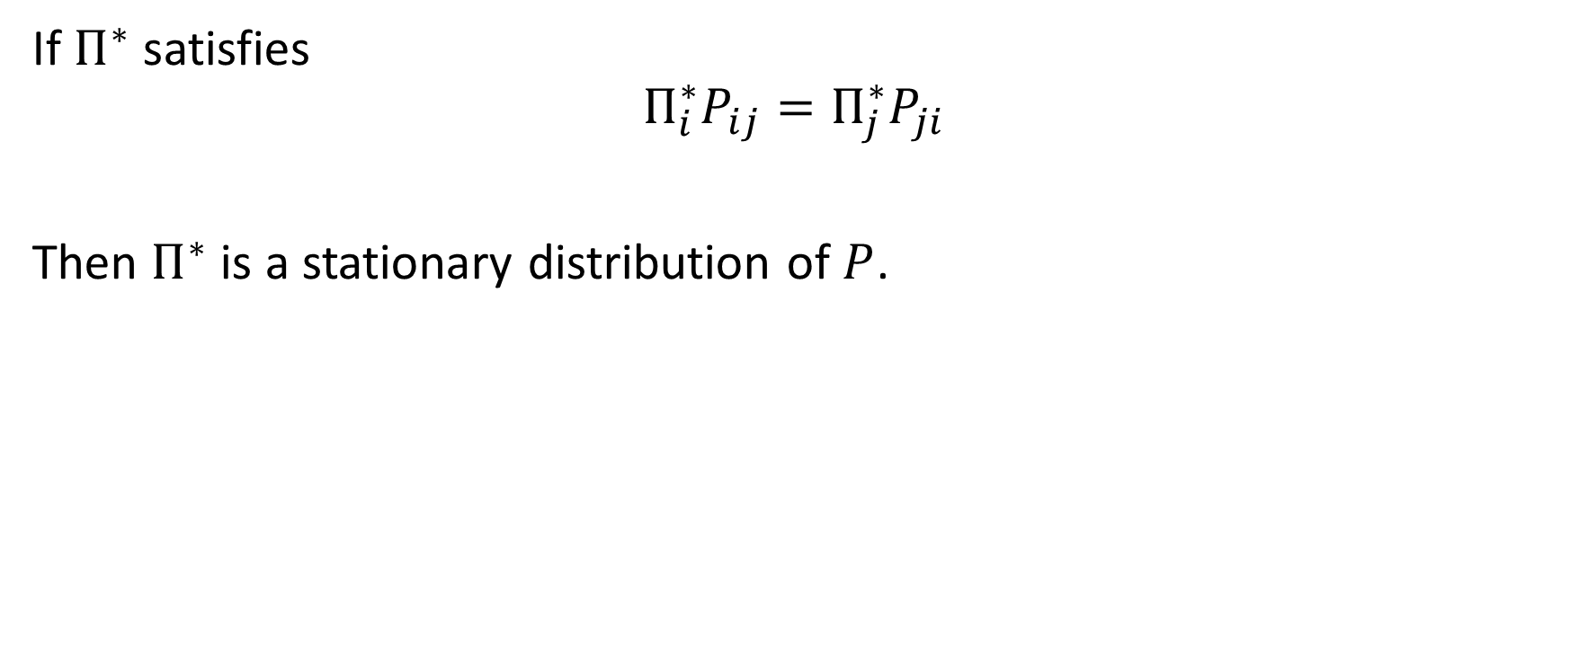
Detailed Balance Condition
If $Π^{∗}$ satisfies
$$Π_{i}^{∗}P_{ij}=Π_{j}^{∗}P_{ji}$$
Then $Π^{∗}$ is a stationary distribution of $P$.

Slide 7
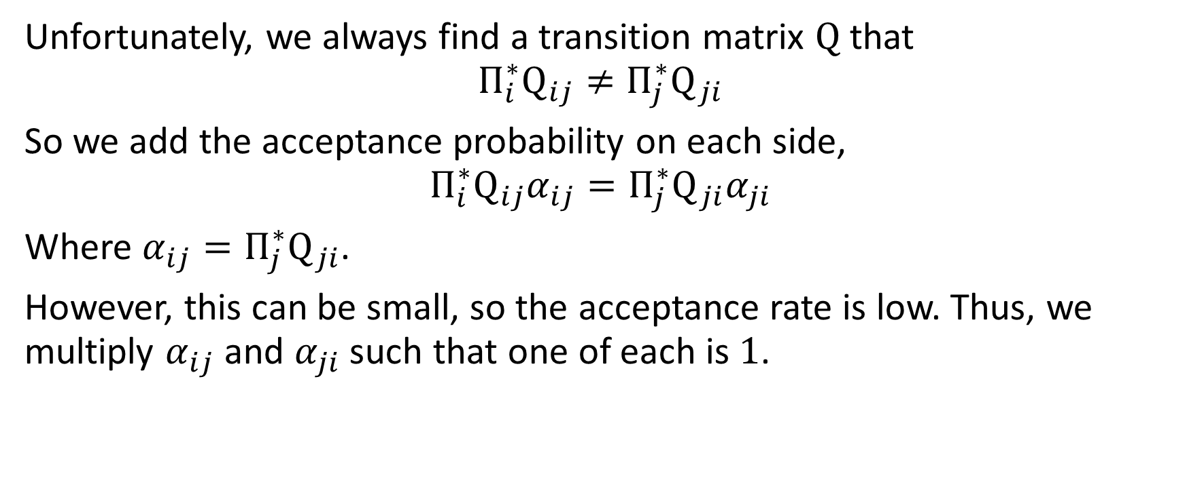
MCMC
Unfortunately, we always find a transition matrix $Q$ that
$$Π_{i}^{∗}Q_{ij}≠Π_{j}^{∗}Q_{ji}$$
So we add the acceptance probability on each side,
$$Π_{i}^{∗}Q_{ij}α_{ij}=Π_{j}^{∗}Q_{ji}α_{ji}$$
Where $α_{ij}=Π_{j}^{∗}Q_{ji}$.
However, this can be small, so the acceptance rate is low. Thus, we multiply $α_{ij}$ and $α_{ji}$ such that one of each is $1$.

Slide 8
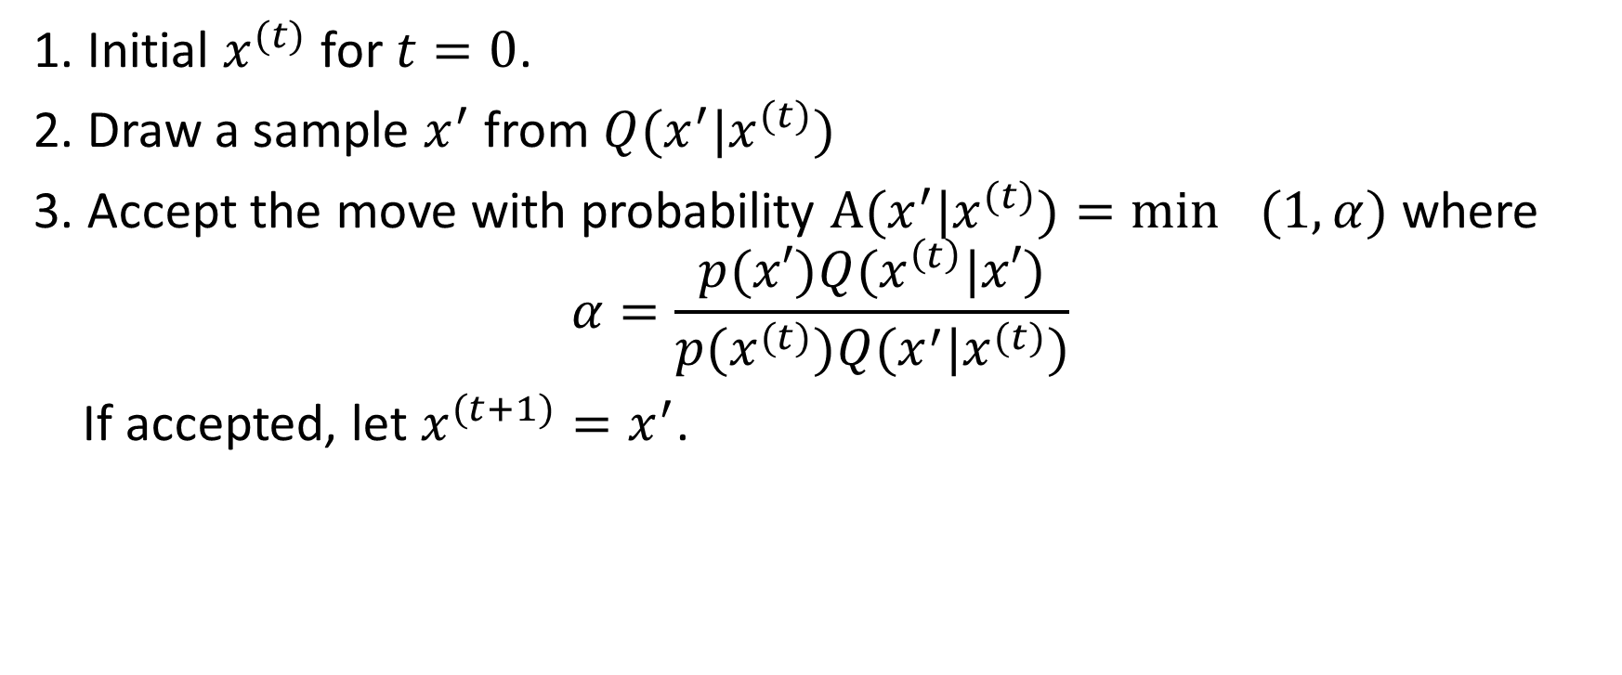
MCMC(Metropolis-Hasting)
1. Initial $x^{(t)}$ for $t=0$.
2. Draw a sample $x^{′}$ from $Q(x^{′}|x^{(t)})$
3. Accept the move with probability $A(x^{′}|x^{(t)})=\min_{}{(1,α)}$ where
$$α=\frac{p(x′)Q(x^{\left(t\right)}|x′)}{p(x^{(t)})Q(x^{′}|x^{(t)})}$$
If accepted, let $x^{(t+1)}=x^{′}$.

Slide 9
Typical Set

Slide 10
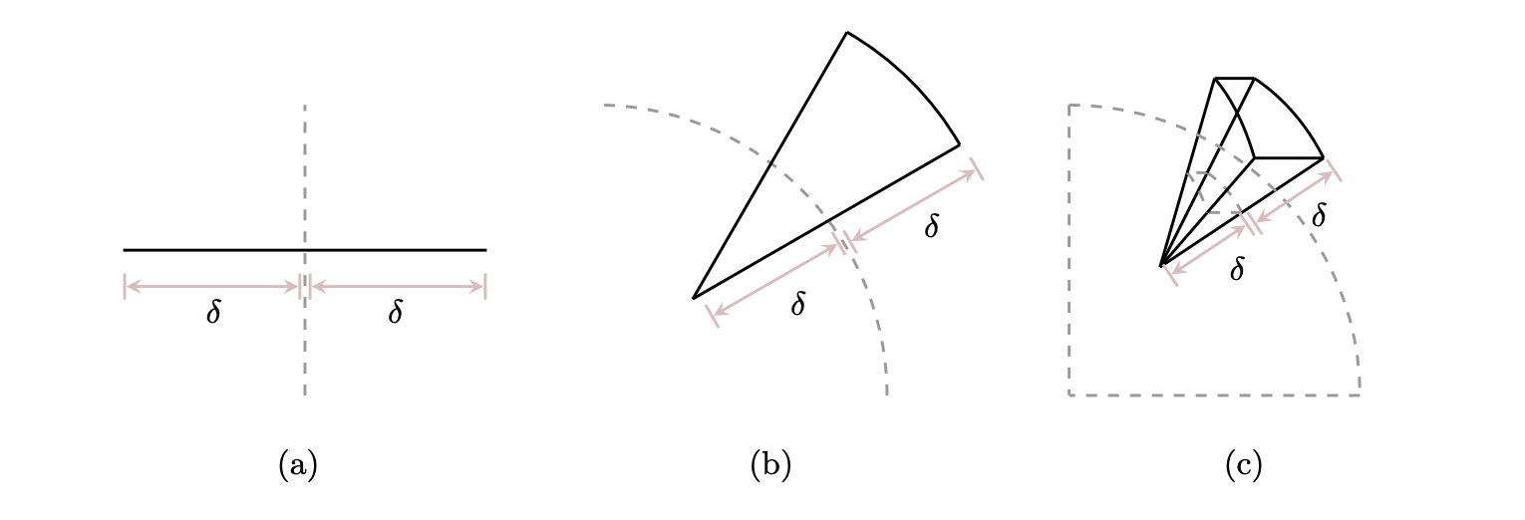
The geometry of High-Dimensional Spaces
There is much more volume outside any given neighborhood than inside of it.
The neighbor around the mode is not the only neighborhood that need to be considered.

Slide 11
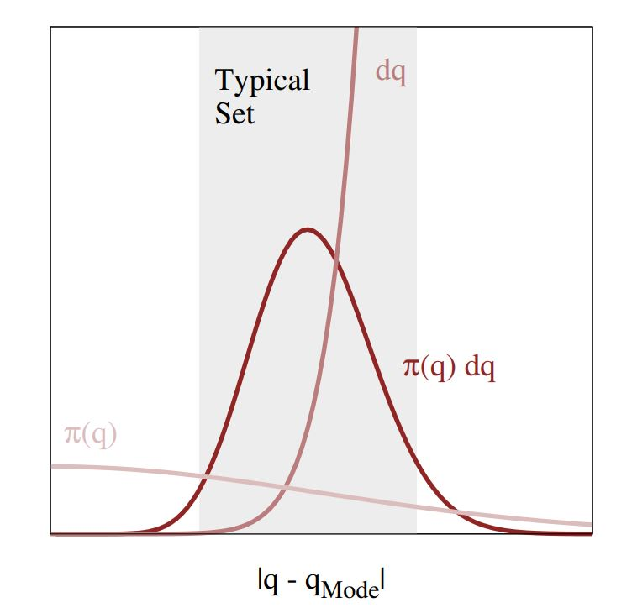
The balance between the density and volume
As the dimension of parameter space increases, the regions where the density and the volume are both large enough to yield a significant contribution becomes more and more narrow.
➛ The only significant contributions to any expectation come from the typical set.

Slide 12


Typical set in High dimension
We have to be able to identify where the typical set lies in parameter space so that we can focus our computational resources where they are most effective.

Slide 13
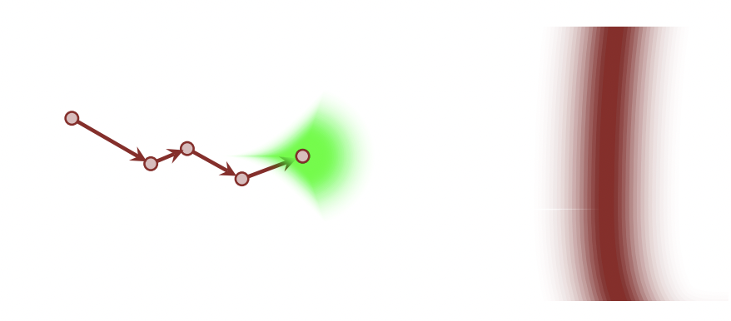
Estimate expectations with Markov Chains
When a Markov transition (green) preserves the target distribution, it concentrates towards the typical set (red).

Slide 14
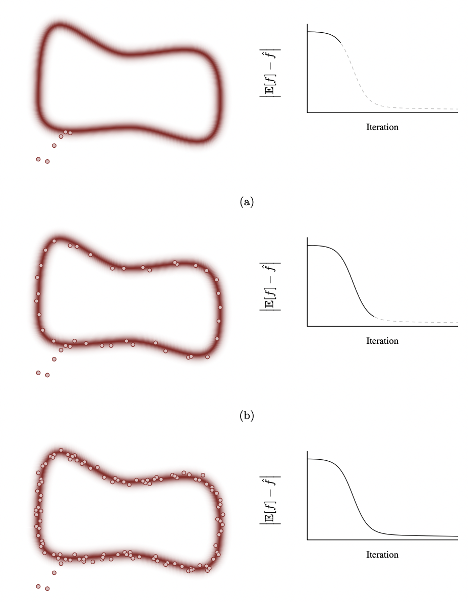
Seems very great, what’s the problem?

Slide 15

Problems of Random Walk Metropolis
The Random Walk Metropolis proposal density (green) is strongly biased towards the outside of the typical set.
➛the acceptance probability vanishes.
(above) larger variance leads to low acceptance rate
(below) smaller variance leads to slow move

Slide 16

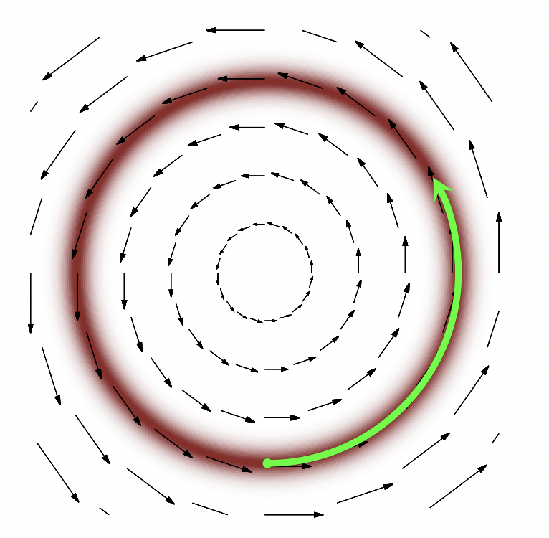
How to solve this problem?
Distill the geometry of the typical set into information
➛encoding a vector field aligned with the typical set

Slide 17
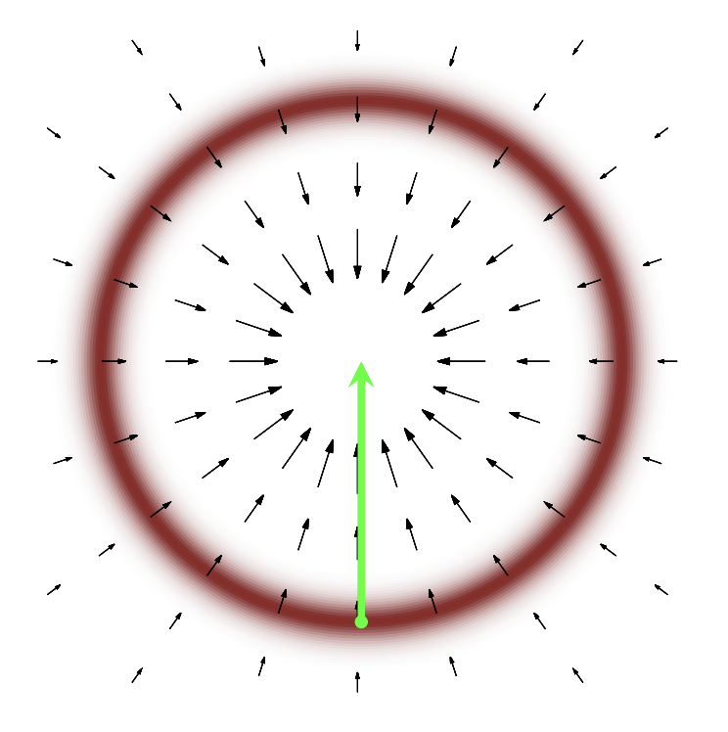
Gradient(?)
Can we use the gradient of the target probability density function?
Ans: NO!

Slide 18
Hamiltonian Monte Carlo

Slide 19
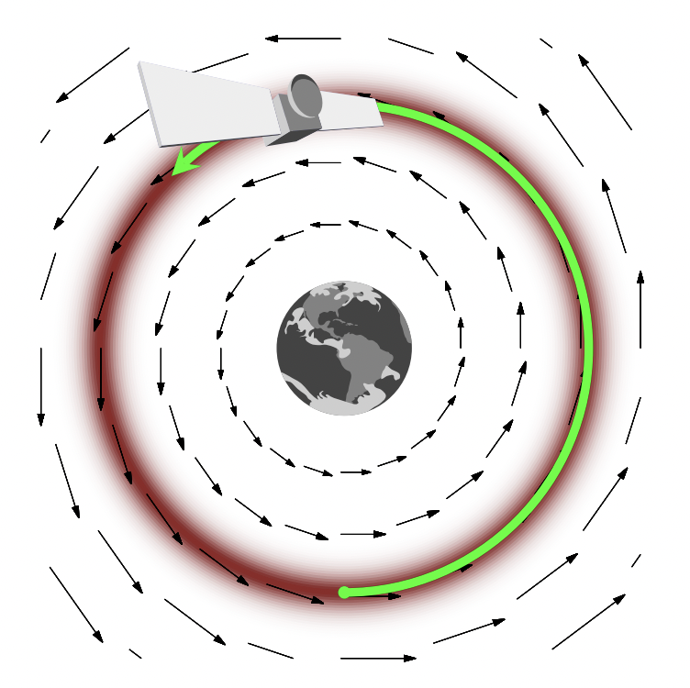
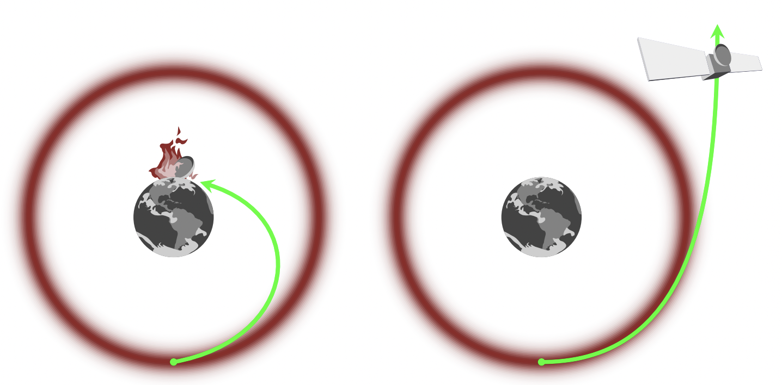
Momentum
Instead of trying to reason about a mode, a gradient, and a typical set,
we can equivalently reason about a planet, a gravitational field, and an orbit.

Slide 20
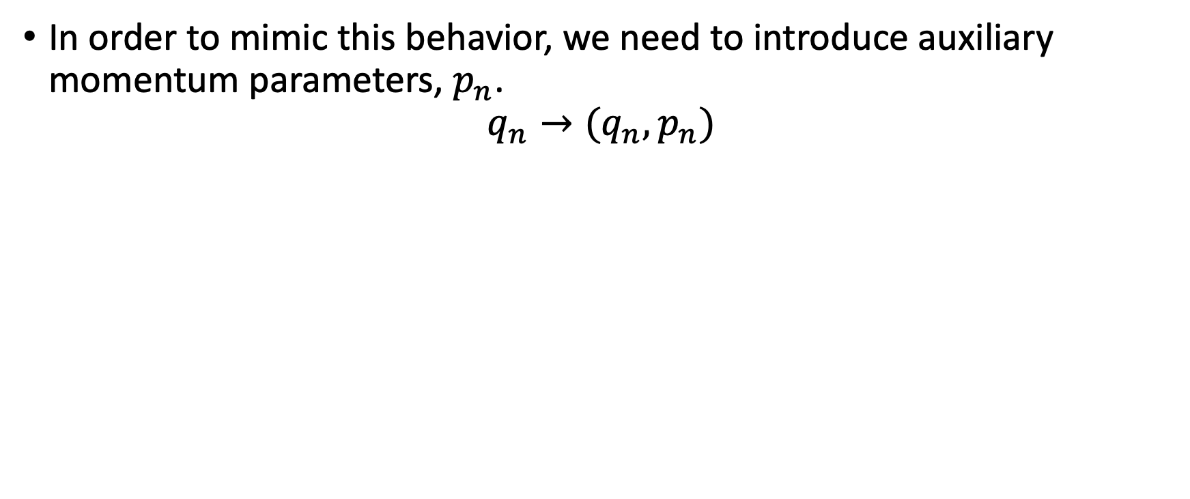
Auxiliary momentum parameters
In order to mimic this behavior, we need to introduce auxiliary momentum parameters, $p_{n}$.
$$q_{n}→(q_{n},p_{n})$$

Slide 21
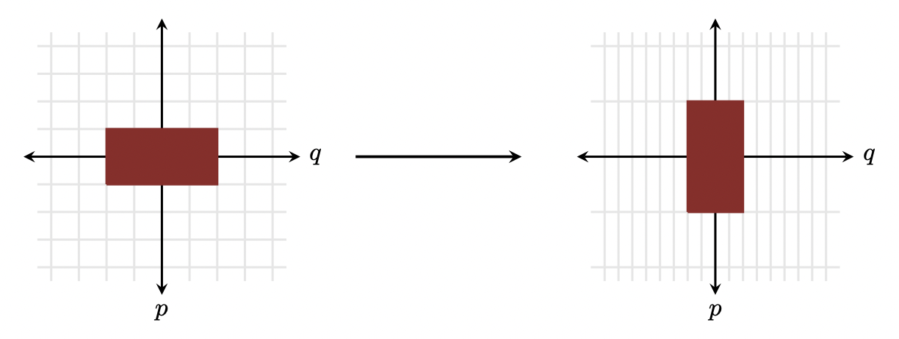
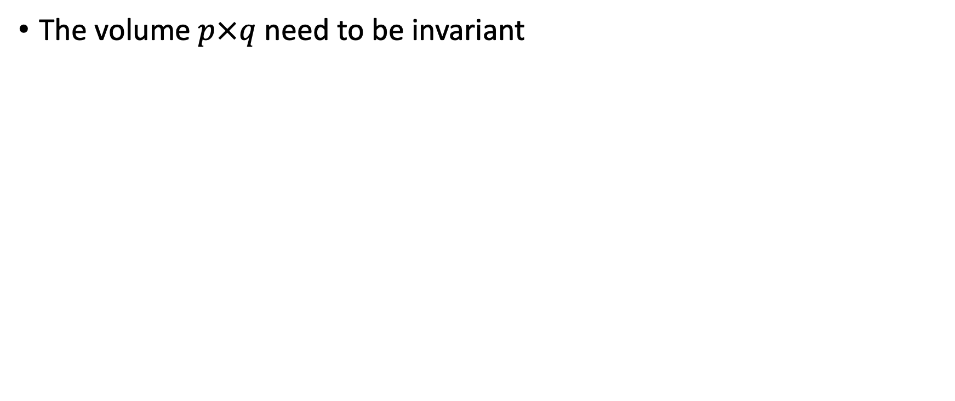
Constraint after adding the momentum
The volume$p×q$ need to be invariant

Slide 22
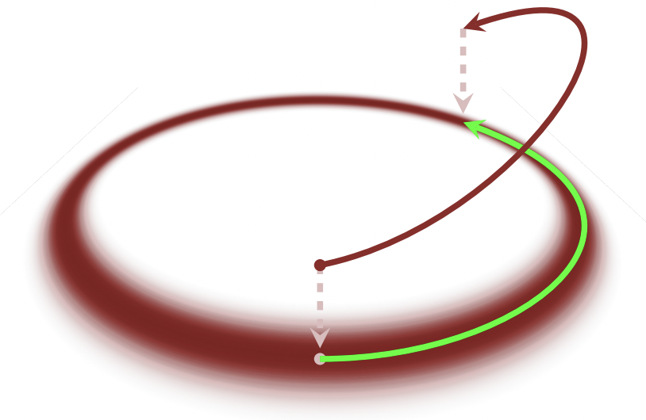
Constraint after adding the momentum
The trajectories exploring the typical set of the phase space distribution will project to trajectories exploring the typical set of the target distribution

Slide 23
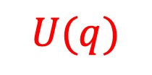
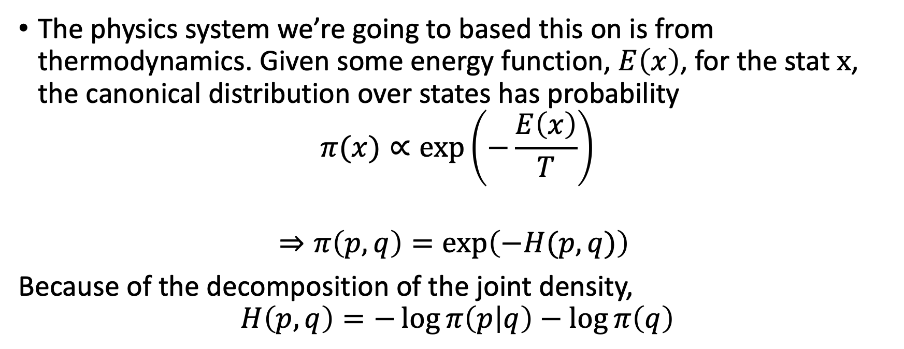
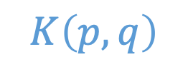
From Thermodynamics to HMC
The physics system we’re going to based this on is from thermodynamics. Given some energy function, $E\left(x\right)$, for the stat $x$, the canonical distribution over states has probability
$$π(x)∝exp⁡\left(−\frac{E\left(x\right)}{T}\right)$$
$$⇒π\left(p,q\right)=exp\left(−H(p,q)\right)⁡⁡$$
Because of the decomposition of the joint density,
$$H\left(p,q\right)=−\log{π\left(p | q\right)}−\log{π\left(q\right)}$$
$$K\left(p,q\right)$$
$$U(q)$$

Slide 24
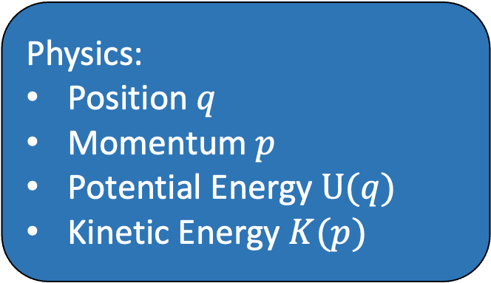
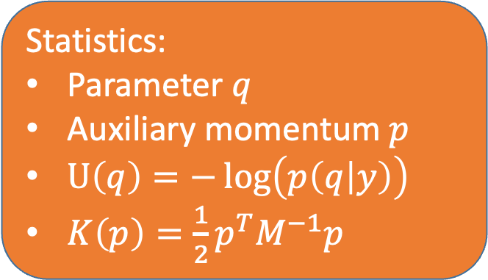
Hamiltonian Monte Carlo
Physics:
Position $q$
Momentum $p$
Potential Energy $U(q)$
Kinetic Energy $K(p)$
Momentum (p)
Statistics:
Parameter $q$
Auxiliary momentum $p$
$U\left(q\right)=−\log\left(p\left(q | y\right)\right)$
$K\left(p\right)=\frac{1}{2}p^{T}M^{−1}p$
Position (q)

Slide 25
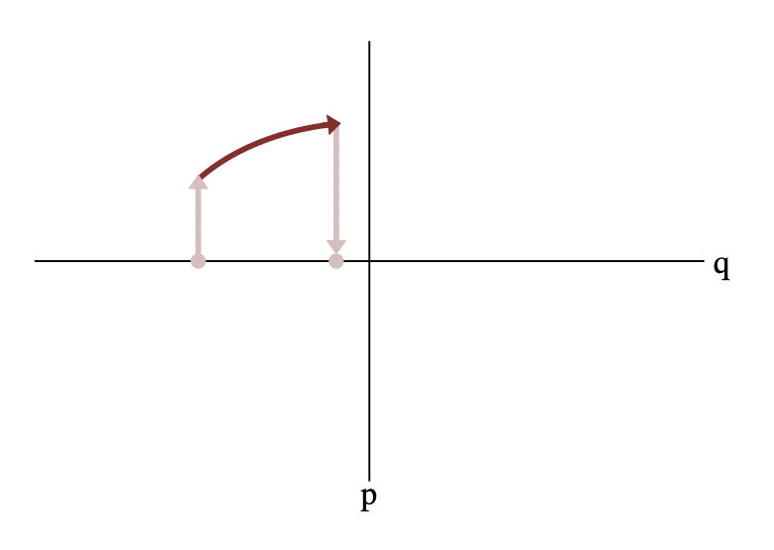
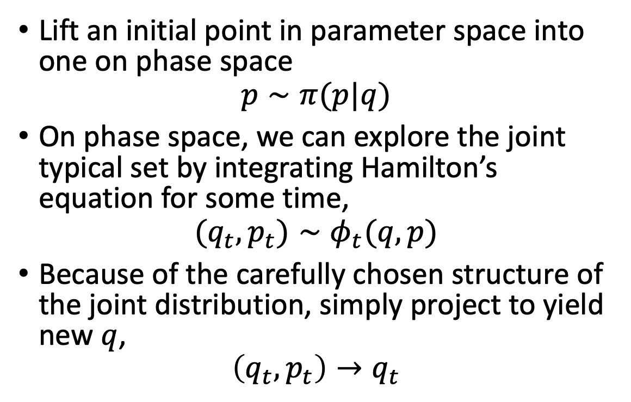
The idealized Hamiltonian Markov Transition
Lift an initial point in parameter space into one on phase space
$$p∼π(p|q)$$
On phase space, we can explore the joint typical set by integrating Hamilton’s equation for some time,
$$(q_{t},p_{t})∼φ_{t}(q,p)$$
Because of the carefully chosen structure of the joint distribution, simply project to yield new $q$,
$$\left(q_{t},p_{t}\right)→q_{t}$$

Slide 26
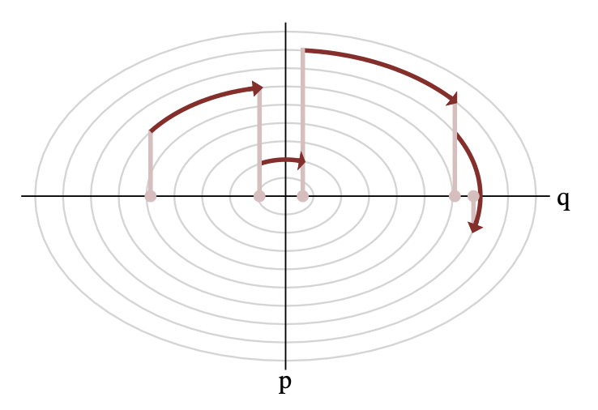
The idealized Hamiltonian Markov Transition
Each Hamiltonian Markov transition lifts the initial state onto a random level set of the Hamiltonian, which can then be explored with a Hamiltonian trajectory before projecting back down to the target parameter space.

Slide 27

Properties of Hamiltonian Dynamics
Physics:
Statistics:
Reversibility
Equilibrium
Conservation of Energy
Acceptance rate $≈$ 1
Volume preservation
Symplecticness
Volume of acceptance rate invariant

Slide 28
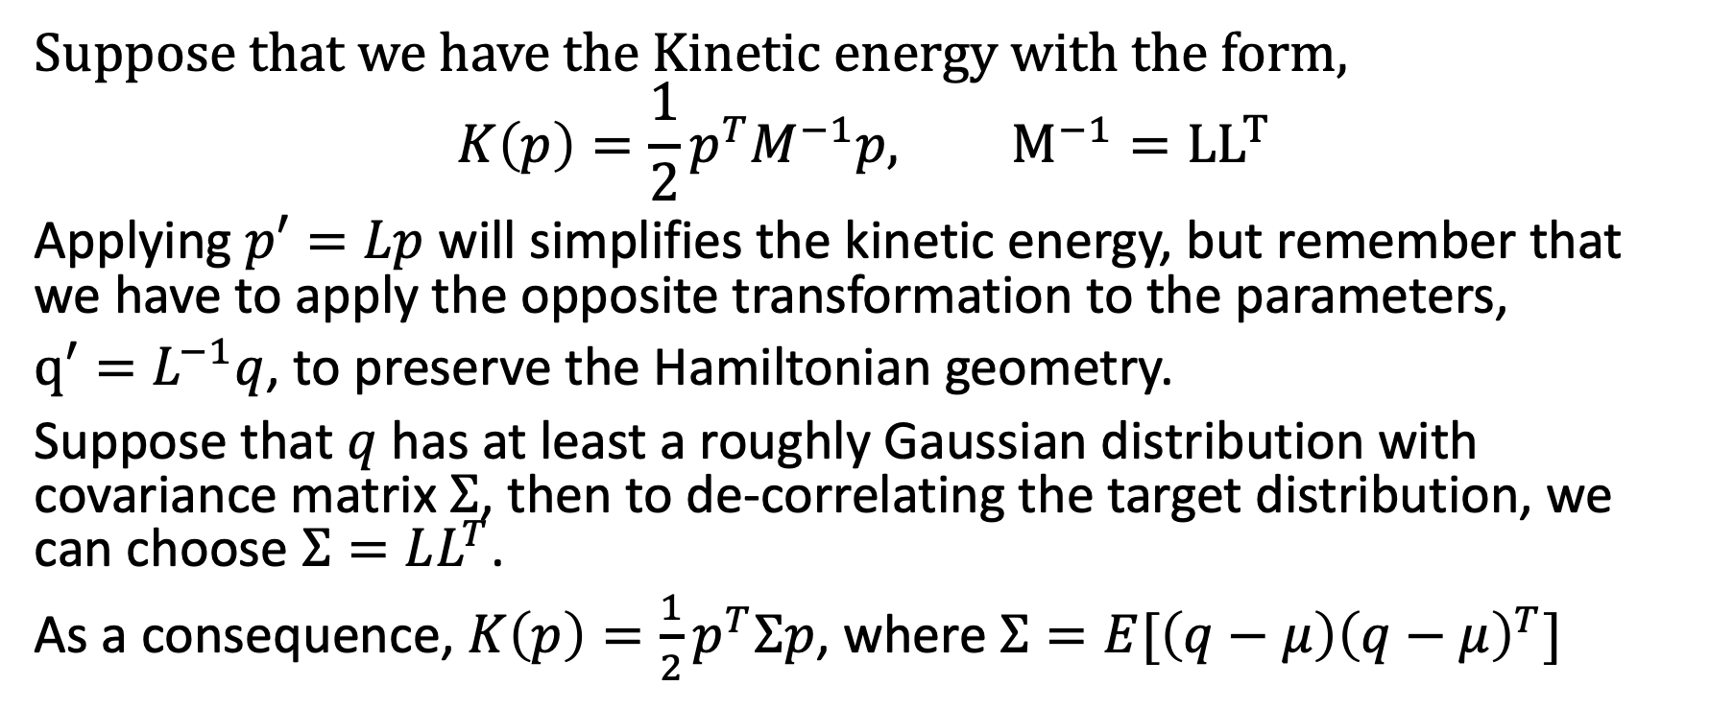
How to choose the M matrix?
Suppose that we have the Kinetic energy with the form,
$$K\left(p\right)=\frac{1}{2}p^{T}M^{−1}p, M^{−1}={LL}^{T}$$
Applying $p′=Lp$ will simplifies the kinetic energy, but remember that we have to apply the opposite transformation to the parameters,
$q′=L^{−1}q$, to preserve the Hamiltonian geometry.
Suppose that $q$ has at least a roughly Gaussian distribution with covariance matrix $Σ$, then to de-correlating the target distribution, we can choose $Σ=LL^{T}$.
As a consequence, $K\left(p\right)=\frac{1}{2}p^{T}Σp$, where $Σ=E[\left(q−μ\right){\left(q−μ\right)}^{T}]$

Slide 29
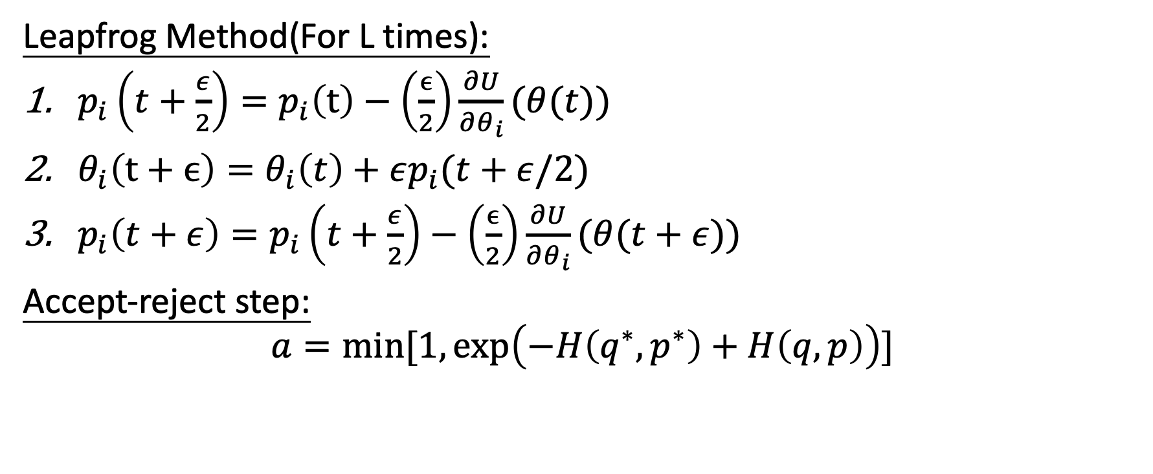
Numerical Methods
Leapfrog Method(For L times):
$p_{i}\left(t+\frac{ε}{2}\right)=p_{i}\left(t\right)−\left(\frac{ϵ}{2}\right)\frac{∂U}{∂θ_{i}}(θ(t))$
$θ_{i}\left(t+ϵ\right)=θ_{i}\left(t\right)+εp_{i}(t+ε/2)$
$p_{i}\left(t+ε\right)=p_{i}\left(t+\frac{ε}{2}\right)−\left(\frac{ϵ}{2}\right)\frac{∂U}{∂θ_{i}}(θ(t+ε))$
Accept-reject step:
$$a=\min{[1,\exp\left(−H\left(q^{∗},p^{∗}\right)+H\left(q,p\right)\right)]}$$

Slide 30
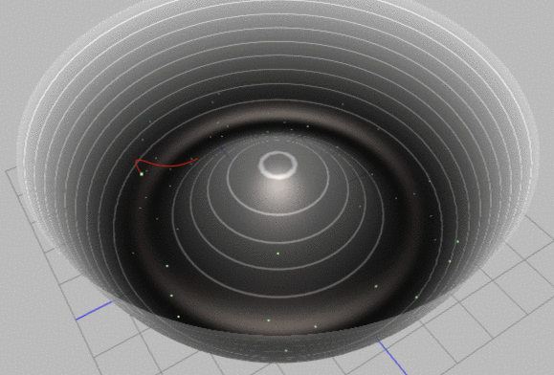
Numerical Methods

